Slide 1
Heapsort
Algorithm : Design & Analysis
[6]

Slide 2
In the last class…
Mergesort
Worst Case Analysis of Mergesort
Lower Bounds for Sorting by Comparison of Keys
  Worst Case
  Average Behavior

Slide 3
Heapsort
Heap Structure and Patial Order Tree Property
The Strategy of Heapsort
Keep the Partial Order Tree Property after the maximal element is removed
Constructing the Heap
Complexity of Heapsort
Accelerated Heapsort

Slide 4

Elementary Priority Queue ADT
“FIFO” in some special sense. The “first” means some kind of “priority”, such as value(largest or smallest)
  PriorityQ create()
    Precondition: none
    Postconditions: If pq=create(), then, pq refers to a newly created object and isEmpty(pq)=true
  boolean isempty(PriorityQ pq)
    precondition: none
  int getMax(PriorityQ pq)
    precondition: isEmpty(pq)=false
    postconditions: **
  void insert(PriorityQ pq, int id, float w)
    precondition: none
    postconditions: isEmpty(pq)=false; **
  void delete(PriorityQ pq)
    precondition: isEmpty(pq)=false
    postconditions: value of isEmpty(pq ) updated; **
**
pq can always be thought as a sequence of pairs (id_{i},w_{i}), in non-decreasing order of w_{i}

Slide 5
Heap: an Implementation of Priority Quere
A binary tree T is a heap structure if:
  T is complete at least through depth h-1
  All leaves are at depth h or h-1
  All path to a leaf of depth h are to the left of all path to a leaf of depth h-1
Partial order tree property
  A tree T is a (maximizing) partial order tree if and only if the key at any node is greater than or equal to the keys at each of its children (if it has any).
A heap is:
A heap structure, satisfying
Partial order tree property

Slide 6
Heap: Examples
The maximal key is always with the root
50
9
24
30
5
7
20
21
18
3
1
4
3
6
12
5
6

Slide 7
Heapsort: the Strategy
heapSort(E,n)
Construct H from E, the set of n elements to be sorted;
for (i=n;i≥1;i--)
curMax = getMax(H);
deleteMax(H);
E[i] = curMax
deleteMax(H)
Copy the rightmost element on the lowest level of H into K;
Delete the rightmost element on the lowest level of H;
fixHeap(H,K)

Slide 8
FixHeap:
Keeping the Partial Order Tree Property
Input: A nonempty binary tree H with a “vacant” root and its two subtrees in partial order. An element K to be inserted.
Output: H with K inserted and satisfying the partial order tree property.
Procedure:
  fixHeap(H,K)
  if (H is a leaf) insert K in root(H);
  else
  Set largerSubHeap;
  if (K.key≥root(largerSubHeap).key) insert K in root(H)
  else
  insert root(largerSubHeap) in root(H);
  fixHeap(largerSubHeap, K);
  return
One comparison:
largerSubHeap is left- or right-Subtree(H), the one with larger key at its root.
Special case: rightSubtree is empty
Recursion
“Vacant” moving down

Slide 9
fixHeap: an Example
vacant
50
24
30
24
30
20
21
18
3
20
21
18
3
12
5
6
12
5
K=6
30
30
24
18
24
20
21
3
20
21
18
3
12
5
K=6
12
5

Slide 10
Worst Case Analysis for fixHeap
2 comparisons at most in one activation of the procedure
The tree height decreases by one in the recursive call
So, 2h comparisons are needed in the worst case, where h is the height of the tree
Procesure:
  fixHeap(H,K)
  if (H is a leaf) insert K in root(H);
  else
  Set largerSubHeap;
  if (K.key≥root(largerSubHeap).key) insert K in root(H)
  else
  insert root(largerSubHeap) in root(H);
  fixHeap(largerSubHeap, K);
  return
One comparison:
largerSubHeap is left- or right-Subtree(H), the one with larger key at its root.
Special case: rightSubtree is empty
Recursion
“Vacant” moving down

Slide 11
Heap Construction
Note: if left subtree and right subtree both satisfy the partial order tree property, then fixHeap(H,root(H)) gets the thing done.
We begin from a Heap Structure H:
  void constructHeap(H)
  if (H is not a leaf)
  constructHeap(left subtree of H);
  constructHeap(right subtree of H);
  Element K=root(H);
  fixHeap(H,K)
  return
root
Post-order Traversal
left
right

Slide 12
Correctness of constructHeap
Specification
  Input: A heap structure H, not necessarily having the partial order tree property.
  Output: H with the same nodes rearranged to satisfy the partial order tree property.
  void constructHeap(H)
  if (H is not a leaf)
  constructHeap(left subtree of H);
  constructHeap(right subtree of H);
  Element K=root(H);
  fixHeap(H,K)
  return
H is a leaf: base case, satisfied trivially.
Preconditions hold respectively?
Postcondition of constructHeap satisfied?

Slide 13
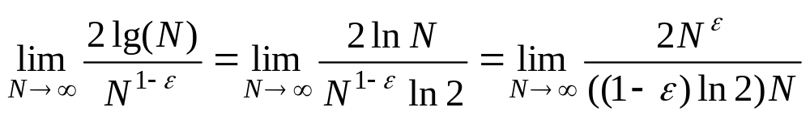

The Heap Is Constructed in Linear Time!
Number of nodes in right subheap
The recursion equation:
W(n)=W(n-r-1)+W(r)+2lg(n)
A special case: H is a complete binary tree:
  The size N=2^{d}-1,
  (then, for arbitrary n, N/2<n≤N≤2n, so W(n)≤W(N)≤W(2n) )
  Note: W(N)=2W((N-1)/2)+2lg(N)
  The Master Theorem applys, with b=c=2, and the critical exponent E=1, f(N)=2lg(N)
  Note:
  When 0<ε<1, this limit is equal to zero
  So, 2lg(N)∈Ο(N ^{E-ε}), case 1 satisfied, we have W(N)∈Θ(N), so, W(n)∈Θ(n)
Cost of fixHeap
For your reference:
Master Theorem – case 1: If f(n)∈O(n^{E-ε}) for some positive ε, then T(n)∈Θ(n^{E})
L’Hôpital’s Rule

Slide 14
Implementing Heap Using Array
50
9
24
30
5
7
20
21
18
3
1
4
3
6
9
5
7
1
4
3
6
12
5
6
50
24
30
20
21
18
3
12
5
6

Slide 15
Looking for the Children Quickly
50
Starting from 1, not zero,
then the j th level has 2^{j-1}
elements. and there are
2^{j-1}-1 elements in the proceeding
j-1 levels altogether.
So, If E[i] is the kth element
at level j, then i=(2^{j-1}-1)+k,
and the index of its left child
(if existing) is
i+(2^{j-1}-k)+2(k-1)+1=2i
24
30
20
21
18
3
12
5
6
50
24
30
20
21
18
3
12
5
6
<5>
<10>
For E[i]:
Left subheap: E[2i]
right subheap: E[2i+1]
The number of children of the nodes on level j on the left of E[i]
The number of node on the right of E[i] on level j

Slide 16
In-space Implementation of Heapsort
Heap implemented as a array (initial)
E[1]: The largest key to be moved to E[n]
E[n]→K: removed to be inserted
Sorted portion
E[1]: The largest key in current heap, to be moved to E[heapsize]
E[heapsize]→K: removed to be inserted
Current heap:
processed by fixHeap

Slide 17
fixHeap Using Array
Void fixHeap(Element[ ] E, int heapSize, int root, Element K)
int left=2*root; right=2*root+1;
if (left>heapSize) E[root]=K; //Root is a leaf.
else
int largerSubHeap; //Right or Left to filter down.
if (left==heapSize) largerSubHeap=left; // No right SubHeap.
else if (E[left].key>E[right].key) largerSubHeap=left;
else largerSubHeap=right;
if (K.key≥E[largerSubHeap].key) E[root]=K;
else E[root]=E[largerSubHeap]; //vacant filtering down one level.
fixHeap(E, heapSize, largerSubHeap, K);
return

Slide 18
Heapsort: the Algorithm
Input: E, an unsorted array with n(>0) elements, indexed from 1
Sorted E, in nondecreasing order
Procedure:
void heapSort(Element[] E, int n)
int heapsize
constructHeap(E,n,root)
for (heapsize=n; heapsize≥2; heapsize--;)
Element curMax=E[1];
Element K=E[heapsize];
fixHeap(E,heapsize-1,1,K);
E[heapsize]=curMax;
return;
New Version

Slide 19
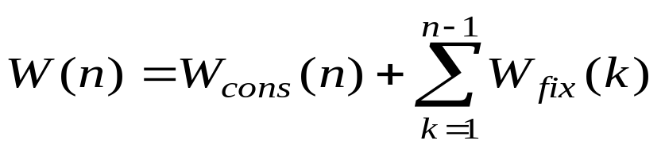
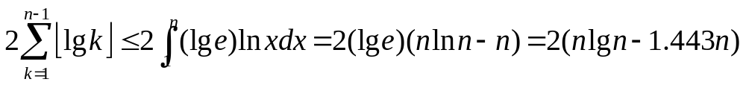
Worst Case Analysis of Heapsort
We have:
It has been known that:
Recall that:
So, W(n) ≤ 2nlgn + Θ(n), that is W(n)∈Θ(nlogn)
Coefficient doubles that of mergeSort approximately

Slide 20
Number of Comparisons in fixHeap
2 comparisons are done in filtering down for one level.
Procesure:
  fixHeap(H,K)
  if (H is a leaf) insert K in root(H);
  else
  Set largerSubHeap;
  if (K.key≥root(largerSubHeap).key) insert K in root(H)
  else
  insert root(largerSubHeap) in root(H);
  fixHeap(largerSubHeap, K);
  return

Slide 21
A One-Comparison-per-Level Fixing
Bubble-Up Heap Algorithm:
  void bubbleUpHeap(Element []E, int root, Element K, int vacant)
  if (vacant==root) E[vacant]=K;
  else
  int parent=vacant/2;
  if (K.key≤E[parent].key)
  E[vacant]=K
  else
  E[vacant]=E[parent];
  bubbleUpHeap(E,root,K,parent);
Bubbling up from vacant through to the root, recursively

Slide 22
Risky FixHeap
In fact, the “risk” is no more than “no improvement”
“Vacant” filtering down:
left vs. right
90
90
65
80
65
80
75
70
75
70
35
60
35
25
60
25
50
Element(55) to be inserted bubling up: element vs. parent
45
50
45
40
40
15
15

Slide 23
Improvement by Divide-and-Conquer
“Vacant” filtering down only half-way
90
90
65
65
80
80
75
70
75
70
35
35
25
60
25
60
45
50
45
50
40
15
40
15
The bubbling up will not beyond last vacStop

Slide 24
Depth Bounded Filtering Down
int promote(Element [ ] E, int hStop, int vacant, int h)
int vacStop;
if (h≤hStop) vacStop=vacant;
else if (E[2*vacant].key≤E[2*vacant+1].key)
E[vacant]=E[2*vacant+1];
vacStop=promote(E, hStop, 2*vacan+1, h-1);
else
E[vacant]=E[2*vacant];
vacStop=promote(E, hStop, 2*vacant, h-1);
return vacStop
Depth Bound

Slide 25
fixHeap Using Divide-and-Conquer
void fixHeapFast(Element [ ] E, Element K, int vacant, int h) //h=⎡lg(n+1)/2⎤ in uppermost call
if (h≤1) Process heap of height 0 or 1;
else
int hStop=h/2;
int vacStop=promote(E, hStop, vacant, h);
int vacParent=vacStop/2;
if (E[vacParent].key≤K.key)
E[vacStop]=E[vacParent];
bubbleUpHeap(E, vacant, K, vacParent);
else
fixHeapFast(E, K, vacStop, hStop)

Slide 26
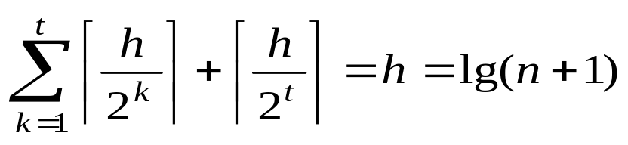
Number of Comparisons in the Worst Case for Accelerated fixHeap
Moving the vacant one level up or down need one comparison exactly in promote or bubbleUpHeap.
In a cycle, t calls of promote and 1 call of bubbleUpHeap are executed at most. So, the number of comparisons in promote and bubbleUpHeap calls are:
At most, lg(h) checks for reverse direction are executed. So, the number of comparisons in a cycle is at most h+lg(h)
So, for accelerated heapSort: W(n)=nlgn+Θ(nloglogn)

Slide 27
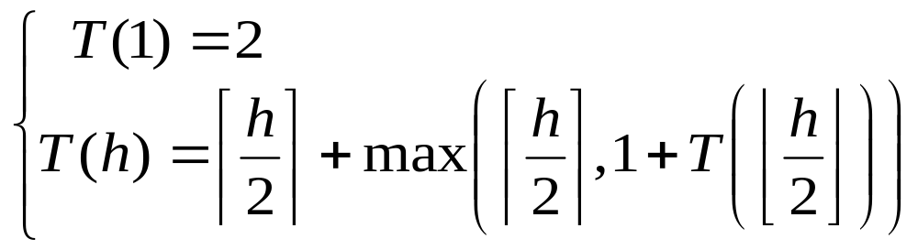
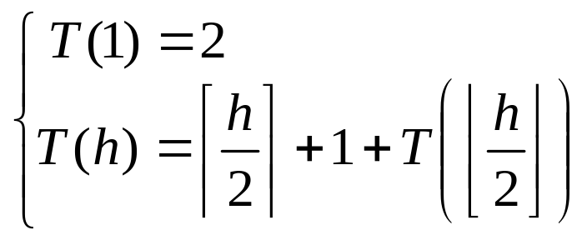
Recursion Equation of Accelerated heapSort
The recurrence equation about h, which is about lg(n+1)
Assuming T(h)≥h, then:

Slide 28
Solving the Recurrence Equation by Recursive Tree
For sorting a sequence of size n, n cycles of fixHeap are executed, so:
n.(h+ ⎡lg(h+1)⎤)
T(n)
⎡h/2⎤+1
T(⎣n/2⎦)
⎡h/4⎤+1
T(⎣n/4⎦)
⎡h/8⎤+1
⎡lg(h+1)⎤ levels
So, the total cost is:
h+ ⎡lg(h+1)⎤
T(1)
1+1

Slide 29
Inductive Proof
The recurrence equation for fixHeapFast:
Proving the following solution by induction:
T(h) = h+⎡lg(h+1)⎤
  According to the recurrence equation:
  T(h+1)=⎡(h+1)/2⎤+1+T(⎣(h+1)/2⎦)
  Applying the inductive assumption to the last term:
  T(h+1)=⎡(h+1)/2⎤+1+⎣(h+1)/2⎦+ ⎡lg(⎣(h+1)/2⎦+1)⎤
  (It can be proved that for any positive integer:
  ⎡lg(⎣(h)/2⎦+1)⎤+1= ⎡lg(h+1)⎤ )
The sum is h+1

Slide 30
Home Assignment
pp.213-
  4.37
  4.38
  4-39
  4-44

